Slide 1
A REPORT ON
GEO-SPATIAL ASSESSMENT OF LAND USE LAND COVER OF BORIPE
LOCAL GOVERNMENT
LOCAL GOVERNMENT OSUN STATE, NIGERIA
BY
OFOBUTU ABIODUN EMMANUEL

Slide 2
1.0 Abstract.
2.0 INTRODUCTION
2.1 Definition of keywords
2.1.1 Study area
3.0 Data source and characteristics
3.1 Year 2000 Landsat 7
3.2 Year 2021 Landsat 8
4.0 Software
4.1 Arc map 10.8 license
4.2 Excel
5.0 Methodology
5.1 Image classification
5.2 Accuracy assessment
6.0 Analysis
6.1 LULC of 2000
6.2 LULC of 2021
6.3 Accuracy Assessment
6.4 Change detection
7.0 conclusion
Reference

Slide 3
Abstract:
One of the most important functions of remote sensing data is the production of Land Use and Land Cover maps and thus can be managed through a process called image classification. This project looks into the following components related to the image classification process and procedures and image classification techniques Boripe local government.
In this kind of classification we make use of Supervised image classification which is based on the idea that a user can select sample pixels in an image that are representative of specific classes and then direct the image processing software to use these training sites as references for the classification of all other pixels in the image.
Geo-spatial assessment of land use/ Land cover dynamics in Boripe Local Government was instigated to bridge the knowledge gap created by data deficiency on the nature, scope and magnitude of land use/ Land cover change in the area. This was done through the analysis of Landsat images of two years from 2000 to 2021.
INTRODUCTION: Land uses are the different types of activities that are carried out on land by anthropogenic activities while land cover is defined by the biophysical attributes of land (natural vegetation, water bodies, rock/soil, sand and wastelands) that have an effect on ecosystem process Land use/land cover (LU/LC) which are mostly influenced by economic, political, cultural and land tenure factors are interconnected and interchangeable in nature.
Land use and land cover change has become a central component in current strategies for managing natural resources and monitoring environmental changes Land use and land cover change (LULC) analysis is essential to understand several environmental processes and social phenomenon as these changes reflect major changes on the Earth’s land surface. The changes have a multiplier effect on natural resource availability, ecosystem/landscape services and biodiversity

Slide 4
STUDY AREA:
Boripe is a Local Government Area in Osun State, Nigeria. Its headquarters are in the town of Iragbiji. It has an area of 132 km (51 sq. mi) and a population of 139,358 at the 2006 census. The postal code of the area is 230.
Boripe local government area covers a total area of 132 square kilometers and has an average temperature of 28 degrees centigrade. The humidity of Boripe LGA averages 51 percent while the wind speed of the area is 11 km/h.
Farming is the major economic activity in Boripe local government area with the area known for the cultivation of crops such as Kolanut, vegetables, cocoyam, and yam. Other important economic activities in Boripe LGA are textile dyeing, herbal medicine preparation and trade of a plethora of commodities.
AIM/OBJECTIVE:
The study aims to produce the land use land cover map of Boripe Local Government area at different epochs to evaluate the changes and predict the future land use/land cover change in the area. This was pursued through the following objectives:
To produce the land use/land cover map of the study area.
To determine the nature and scope of change through the analysis of the map produced
To predict the future change in the area
To evaluate the implication of the change on the overall socio-economic development of the area

Slide 5
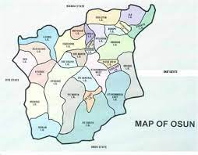
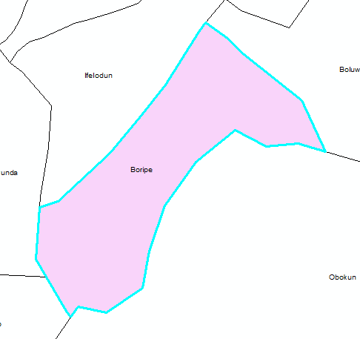
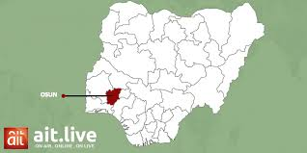
Study area

Slide 6
DATA SOURCE AND CHARACTERISTICS: Data used are Landsat 7 & 8 Imagery which are downloaded from United States Geological Survey site (earthexplorer.usgs.gov) and also Boripe Local government shape file gotten from Nigeria Geo-database.
YEAR 2000 Landsat 7: Landsat 7 ETM+ Satellite Sensor (15m)
The Landsat 7 ETM+ satellite sensor was successfully launched from the Vandenburg Air Force Base on April 15, 1999. Landsat 7 satellite is equipped with Enhanced Thematic Mapper Plus (ETM+), the successor of TM. The observation bands are essentially the same seven bands as TM, and the newly added panchromatic band 8, with a high resolution of 15-meters was added. An instrument malfunction occurred on May 31, 2003, with the result that all Landsat 7 scenes acquired since July 14, 2003, have been collected in "SLC-off" mode.
YEAR 2021 Landsat 8:
Landsat 8 (formerly the Landsat Data Continuity Mission, or LDCM) was launched on an Atlas-V rocket from Vandenberg Air Force Base, California on February 11, 2013. The satellite carries the Operational Land Imager (OLI) and the Thermal Infrared Sensor (TIRS) instruments. The OLI measures in the visible, near infrared, and shortwave infrared portions (VNIR, NIR, and SWIR) of the spectrum. The TIRS measures land surface temperature in two thermal bands with a new technology that applies quantum physics to detect heat. Landsat 8 images have 15-meter panchromatic and 30-meter multi-spectral spatial resolutions along a 185 km (115 mi) swath.

Slide 7
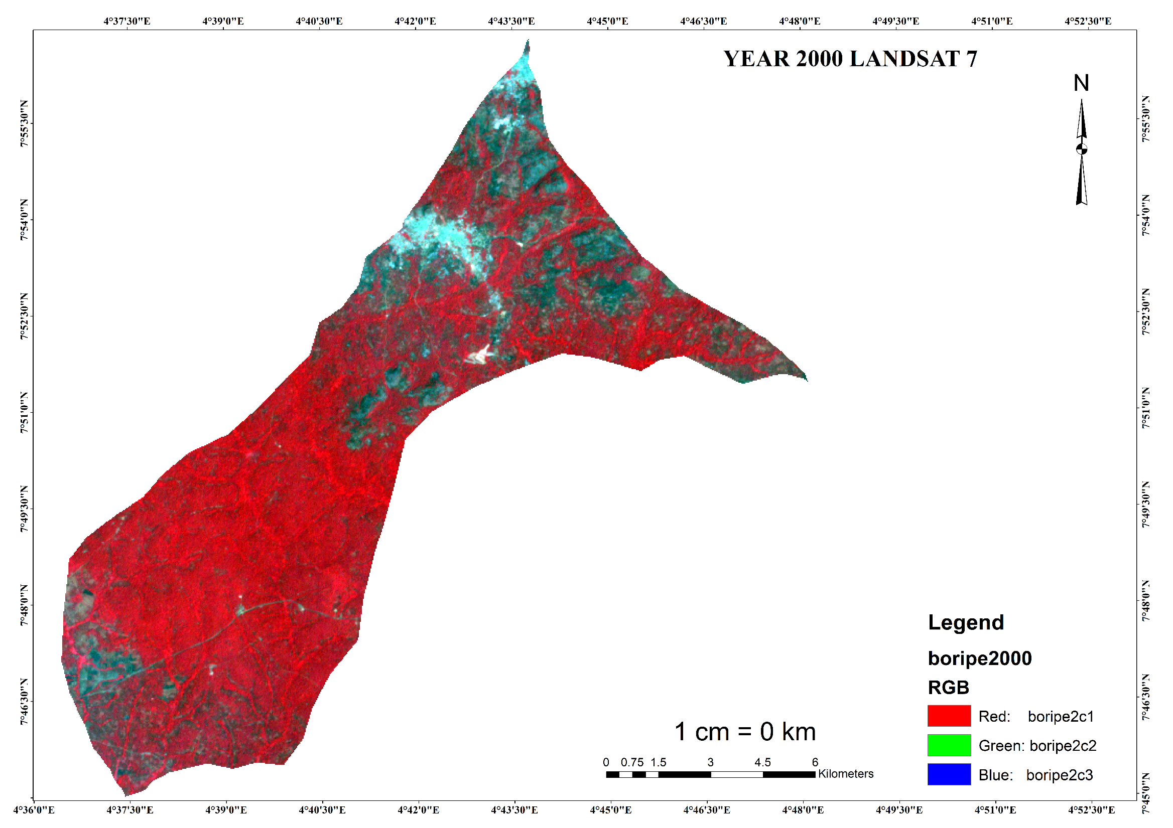

Slide 8
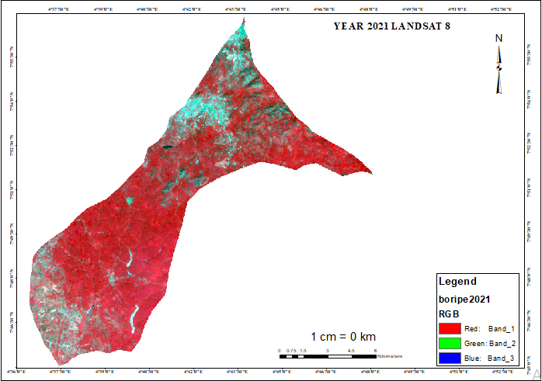

Slide 9
SOFTWARE:
ARCMAP: Arc Map is the main component of Esri's ArcGIS suite of geospatial processing programs, and is used primarily to view, edit, create, and analyze geospatial data. Arc Map allows the user to explore data within a data set, symbolize features accordingly, and create maps. This is done through two distinct sections of the program, the table of contents and the data frame.
EXCEL: Microsoft Excel is a spreadsheet program that is included in the Microsoft Office Suite of applications. Spreadsheets present tables of values arranged in rows and columns that can be manipulated mathematically using both basic and complex math operations and functions.
METHODOLOGY: Supervised classification uses the spectral signatures obtained from training samples to classify an image. With the assistance of the Image Classification toolbar, you can easily create training samples to represent the classes you want to extract. You can also easily create a signature file from the training samples, which is then used by the multivariate classification tools to classify the image
Supervised classification is based on the idea that a user can select sample pixels in an image that are representative of specific classes and then direct the image processing software to use these training sites as references for the classification of all other pixels in the image. Training sites (also known as testing sets or input classes) are selected based on the knowledge of the user. The user also sets the bounds for how similar other pixels must be to group them together. These bounds are often set based
on the spectral characteristics of the training area, plus or minus a certain increment (often based on “brightness” or strength of reflection in specific spectral bands). The user also designates the number of classes that the image is classified into. Many analysts use a combination of supervised and unsupervised classification processes to develop final output analysis and classified maps. In supervised classification the user or image analyst “supervises” the pixel classification process.

Slide 10
Steps involved in Supervised Classification: A supervised classification algorithm requires a training sample for each class, that is, a collection of data points known to have come from the class of interest. The classification is thus based on how
“close” a point to be classified is to each training sample. We shall not attempt to define the word “close” other than to say that both Geometric and statistical distance measures are used in practical pattern recognition algorithms. The training samples are representative of the known classes of interest to the analyst.
Basic steps of supervised classification
(i) Training stage: The analyst identifies representative training areas and develops numerical descriptions of the spectral signatures of each land cover type of interest in the scene. Training sites are areas that are known to be representative of a particular land cover type. The computer determines the spectral signature of the pixels within each training area, and uses this information to define the statistics, including the mean and variance of each of the classes. Preferably the location of the training sites should be based on field collected data or high resolution reference imagery. It is important to choose training sites that cover the full range of variability within each class to allow the software to accurately classify the rest of the image. If the training areas are not representative of the range of variability found within a particular land cover type, the classification may be much less accurate. Multiple, small training sites should be selected for each class. The more time and effort spent in
collecting and selecting training site the better the classification results.
(ii) The classification stag (Decision Rule) or Generate signature file: Each pixel in the image data set is categorized into the land cover class it most closely resembles. If the pixel is insufficiently similar to any training data set it is usually labeled ‘Unknown’.
(iii) The output stage or Classify: The results may be used in a number of different ways. Three typical forms of output products are thematic maps, tables and digital data files which become input data for GIS. The output of image classification becomes input for GIS for spatial analysis of the terrain. depicts the flow of operations to be performed during image classification of remotely sensed data of an area which ultimately leads to create database as an input for GIS. Plate 6 shows the land use/ land
cover color coded image, which is an output of image for supervised image classification, you first create training samples. For example, you mark urban areas by marking them in the image. Then, you would continue adding training sites representative in
the entire image.

Slide 11
For each land over class, you continue creating training samples until you have representative samples for each class. In turn, this would generate a signature file, which stores all training samples spectral information.
Supervised Classification Principles :
The classifier learns the characteristics of different thematic classes – vegetation, Built-up, Outcrops this happens by means of analyzing the statistics of a small sets of pixels in each class that are reliably selected by a human analyst through experience or with the help of a map of the area.
Maximum likelihood Classification:
Maximum likelihood Classification is a statistical decision criterion to assist in the classification of overlapping signatures; pixels are assigned to the class of highest probability. Assumes that the statistics for each class in each band are normally distributed and calculates the probability that a given pixel belongs to a specific class. Each pixel is assigned to the class that has the highest probability (that is, the maximum likelihood).
This is the default.
The maximum likelihood classifier is considered to give more accurate results than parallelepiped classification however it is much slower due to extra computations. We put the word `accurate' in quotes because this assumes that classes in the input data have a Gaussian distribution and that signatures were well selected; this is not always a safe assumption.

Slide 12
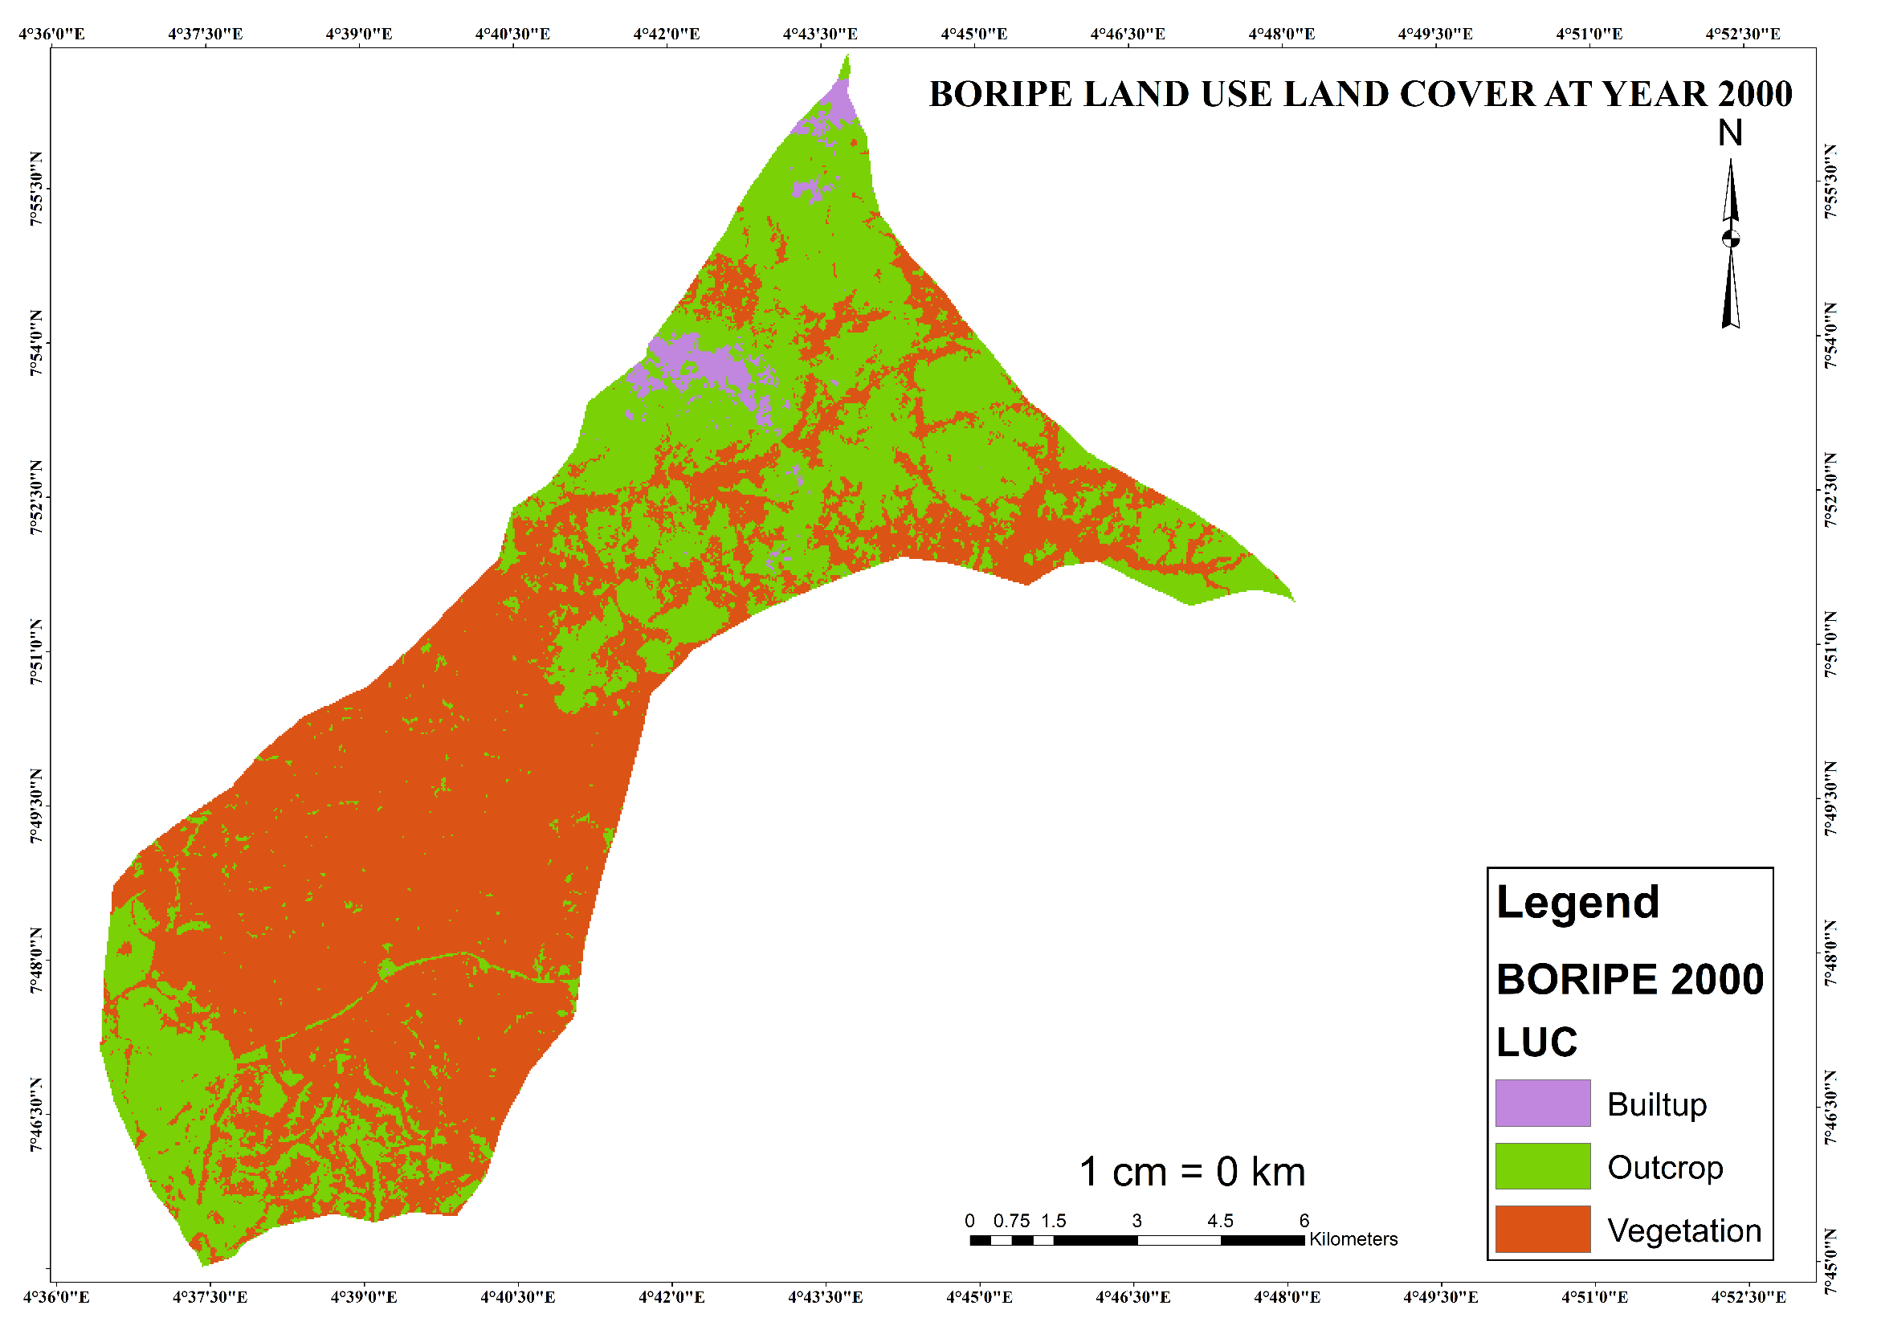

Slide 13
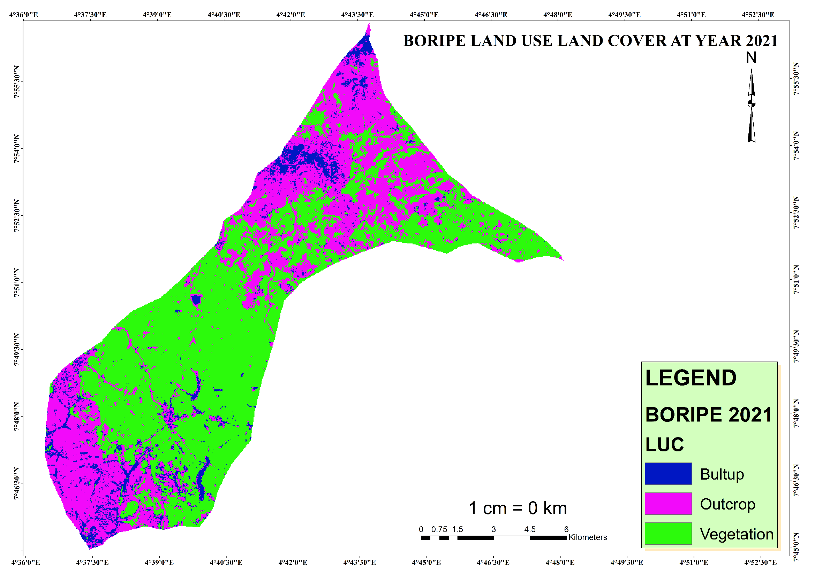

Slide 14
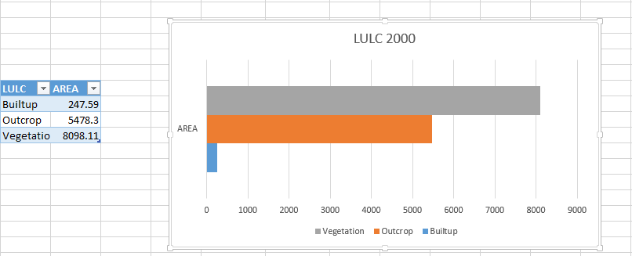
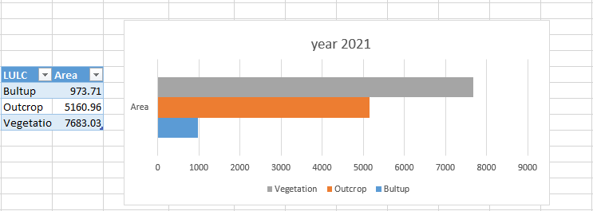

Slide 15
Accuracy assessment: Is an important part of any classification project. It compares the classified image to another data source that is considered to be accurate or ground truth data. Ground truth can be collected in the field; however, this is time consuming and expensive. Ground truth data can also be derived from interpreting high-resolution imagery, existing classified imagery, or GIS data layers.
The most common way to assess the accuracy of a classified map is to create a set of random points from the ground truth data and compare that to the classified data in a confusion matrix. Although this is a two-step process, you may need to compare the results of different classification methods or training sites, or you may not have ground truth data and are relying on the same imagery that you used to create the classification. To accommodate these other workflows, this process uses three geo-processing tools: Create Accuracy Assessment Points, Update Accuracy Assessment Points, and Compute Confusion Matrix.

Slide 16
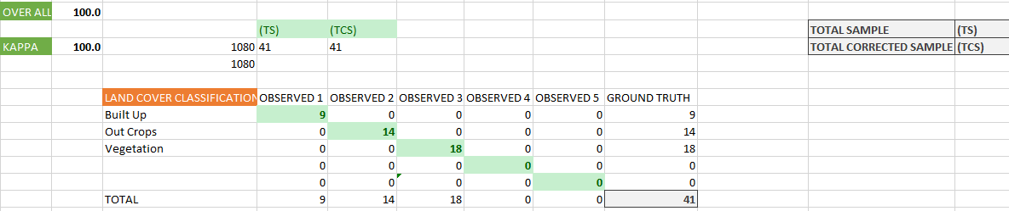
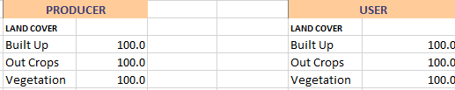
Accuracy assessment of year 2000

Slide 17
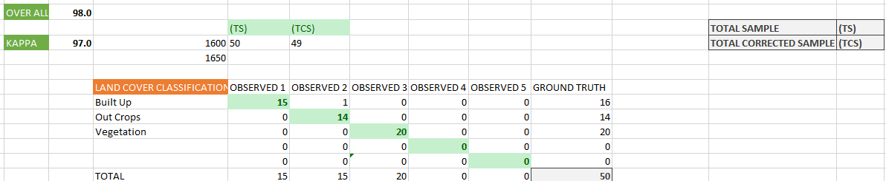
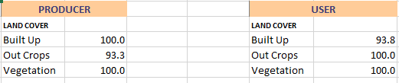
Accuracy assessment of year 2021

Slide 18
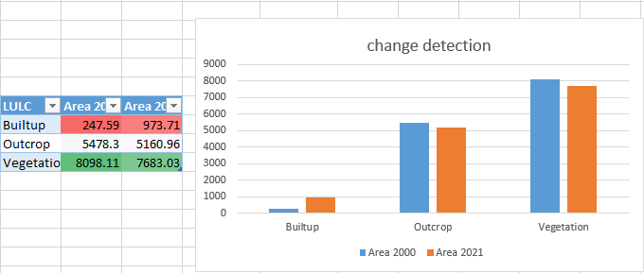
Change Detection: Change detection involves quantifying temporal effects using multi temporal data sets. When one is interested in knowing the changes over large areas and at frequent interval satellite data are commonly used. Results of the digital analysis to a large extent depend on the algorithms used. This study compares effectiveness of various change detection

Slide 19
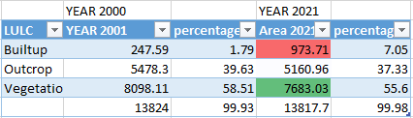
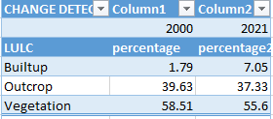
CONCLUSION: The study has shown that built up area in the study area is increasing by 5.26 percent the vegetation and farmland are reducing by 2.91percent, However, the change in the second epoch for built up was higher than the first epoch. Due to deforestation for construction also the out crop in the second epoch as decrease by 2.91 percent with the second epoch due to weathering.
Reference:
1. Verburg PH, Neumann K, Nol L. Challenges in using land use and land cover data for global change studies. Glob. Change Biol. 17:974-989. 2011;5(11):79- 96
2. Local Government Administration and the Development of Boripe Local Government, Osun State, Nigeria. Asian Research Journal of Arts & Social Sciences; 2019. DOI: 10.9734/arjass/2019/v8i330099
3. "Post Offices- with map of LGA". NIPOST. Archived from the original on 2009-10-07. Retrieved 2009-10-20.
4. Zubair Opeyemi A, Ji Wei and Festus Olusola. Urban Expansion and the Loss of Prairie and Agricultural Lands: A Satellite Remote-Sensing-Based Analysis at a SubWatershed Scale; 2019.

